Slide 1
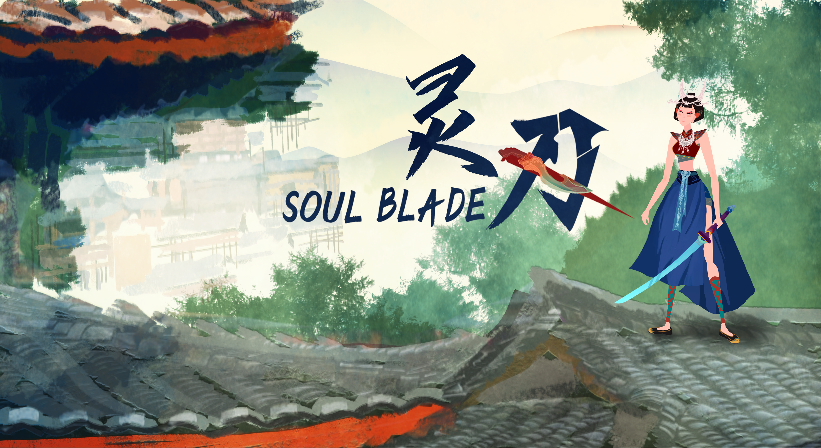
Elder Iron
Version 1.0.7

Slide 2
Abstract
Our team is working on Combat system for prototype：
Added enemy attack, death animation, the second version Character had been completed(Not implement yet)
Added enemy AI behaviour tree, Demo’ enemy AI are provided for player test.
Added parallax scrolling background, Artists had provided high priority scene assets, for designers to combine together.
Added scene VFX, enemy attack VFX (Not implement yet)
Added character attack SFX, background music style will be provided to Client by Jordon directly.

Slide 3

Enemy animation presenting
Attack
Death

Slide 4
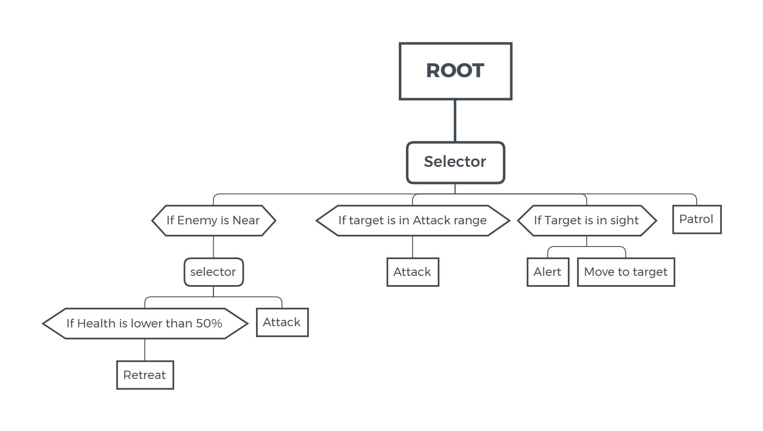
AI Behaviour tree
In this version we added AI behaviour tree to enemy. We plan to give players AI experience of action game in this demo.
Enemy’s behaviour for now:
Attack;
Drawback;
Alert;
Patrol;

Slide 5
Fog VFX(GIF)

Slide 6
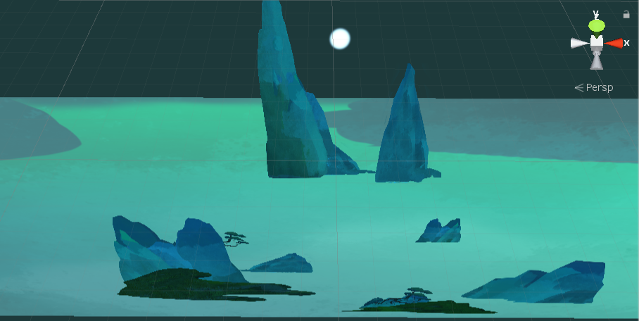
Parallax scrolling
Layer’s for Parallax scrolling background

Slide 7
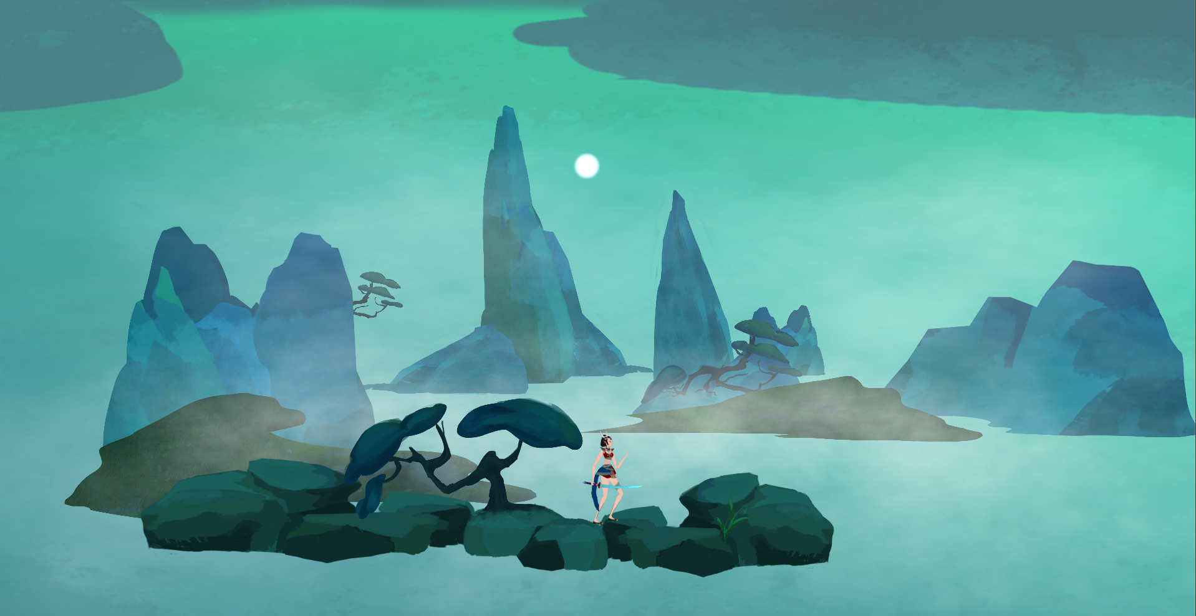
Parallax scrolling
Combination of different layers

Slide 8
Development Plan
Our team will working on Boss fight from next week：
Boss character；
Boss fight background；
Boss skills animation；
Boss skills design；
Meanwhile we will try to adjust combat feeling by players’ feedback and changing keyboard settings, refine scene and character animation, implement theses functions we had not show in this week demo.

Slide 9
Thanks！

